Slide 1
jQuery
Web Programming

Slide 2
What is jQuery?
jQuery is a library, or set of helpful add-ons, to the JavaScript programming language that simplifies HTML document event handling and animation for rapid web development.

Slide 3
Why learn jQuery?
Write less, do more
Easy to learn
Performance
Plugins
It’s fun!!!

Slide 4
What can we do with jQuery?
We've been building web pages using HTML and styling them using CSS. Our pages look great, but they're not interactive. jQuery allows us to:
Drag elements around the page
Open and close sliding panels
Animate HTML elements
Add new elements to our HTML pages simply by clicking a button.
And much more

Slide 5
The Document Object Model
To get the most out of jQuery, we should review how an HTML page is put together.
An HTML document is structured according to the Document Object Model, or DOM. It's by interacting with the DOM that jQuery is able to access and modify HTML.
The DOM consists of every element on the page, laid out in a hierarchical way that reflects the way the HTML document is ordered. Think of the DOM as a tree. Just like an HTML document, elements in the DOM can have parents, children, and siblings.

Slide 6
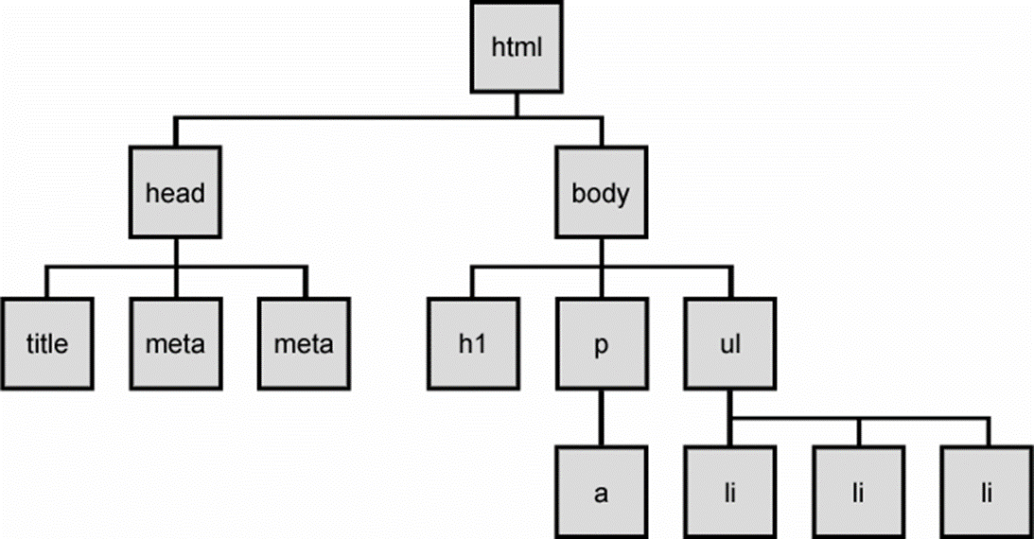
The DOM tree

Slide 7
Linking Your HTML and JavaScript Files
Just like we need a <link> tag to connect our HTML and CSS,
we need a <script> tag to connect our HTML and jQuery.
The tag looks like this:
<script src="https://code.jquery.com/jquery-1.12.4.js"></script>
<script src="https://code.jquery.com/ui/1.12.1/jquery-ui.js"></script>
<script type="text/javascript" src="script.js"></script>
Note that the <script> tag is not self-closing; it requires a
closing </script> tag.

Slide 8
jQuery compared to CSS
Just like the CSS div refers to the HTML element <div>,
the jQuery 'div' refers to the same HTML element <div>.
You can think of the element name passed to jQuery as identical to the
CSS element, only wrapped in quotes.
For instance, if you want to target anything of class=“button” in your HTML file:
In CSS, you would use .button
In jQuery, you would use $('.button').someAction

Slide 9
Getting Started
We start up our jQuery magic using the
$(document).ready(something);
It works like this:
The $() says, "hey, jQuery things are about to happen!"
Putting document between the parentheses tells us that
we're about to work our magic on the HTML document itself.
The .ready(); is a function, or basic action, in jQuery.
It says "hey, I'm going to do stuff as soon as the HTML
document is ready!"
Whatever goes in .ready()'s parentheses is the jQuery
event that occurs as soon as the HTML document is ready.

Slide 10
The Functional Approach
Now we need to put something inside our ready() function.
Remember, when we say "function," you can think "action."
Functions are the basic unit of doing work in jQuery.
For this reason, jQuery includes a function keyword which looks like this:
function(){ jQuery magic; }
If we add our function inside our .ready(), jQuery will run the code in our
function as soon as the HTML document loads.
The syntax would then look like this:
$(document).ready(function() { jQuery magic; });
Remember, to end the jQuery statements with a semicolon

Slide 11
Parts of a Function:
A function is made up of three parts:
The function keyword
Any inputs that function takes (they go between the ()s and are separated by
commas if there are more than one)
Whatever actions the function should perform (these go between the {}s).
The general form is:
function(input1, input2, etc) {
Do a thing
Do another thing
Do yet another thing! }

Slide 12
Function keywords
Here’s a small sample of some of the functions available through jQuery:
.hide()
.fadeTo()
.fadeIn()
.fadeout()
.mouseenter()
.mouseleave()
.slideDown()
.hover()
.click()
.dblclick()
Many more.

Slide 13
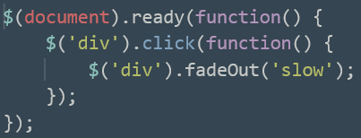
Example using .Click() and .fadeOut()
The main entry point of most jQuery applications is a block of
code that looks like this:
$(document).ready(function() { Do something });
What do you think this block of code will produce:

Slide 14
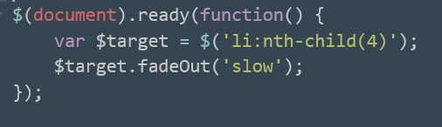
Variables
Variables are a place for us to store information for use at a later time.
Variables can hold any type of information you work with, so just think of them as containers.
For instance, in jQuery, you can write
var lucky = 7;
var name = "Codecademy";
var $p = $('p');
Our first variable contains a number, 7,
while the second variable contains some text, "Codecademy".
Our 3rd variable stores the result of a jQuery selector $('p') in the variable $p .
Example:

Slide 15
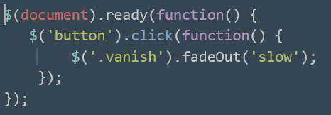
Selecting by Class
We don't have to limit ourselves to selecting HTML elements
like <p> and <div>; essentially, we can put any CSS selector in
quotes and pass it into $(). This means we can select classes, too!
Recall that we can select classes in CSS by using a dot (.).
If we have class="red" in our HTML, we can target it in CSS with .red.
In jQuery, all we need to do is put '.red' in quotes, and we can
pass it to $() to make a jQuery object.
Example:

Slide 16
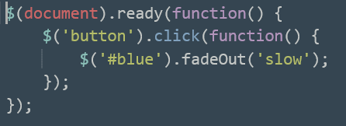
Selecting by ID
If we can select by class, it follows that we can also select by ID.
We do this by putting the ID name (in quotes) inside $(). Just as we
need the . for classes, we need the # for IDs.
We could target id="header" like so:
$('#header');
The semicolon at the end is important—it's how jQuery knows we're
done giving it a command.
Example:

Slide 17
Flexible Selections
Anything you can target with CSS, you can modify with jQuery.
For example, we can apply a fadeTo() to a p selector like this:
$('p').fadeTo('slow', 0);
We can apply a fadeTo() to an li selector like this:
$('li').fadeTo('slow', 0);
We can apply a fadeTo() to both the p and li selectors like this:
$('p, li').fadeTo('slow', 0);
This is called a compound selector.

Slide 18
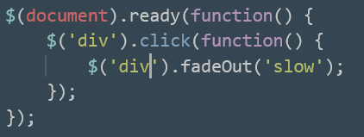
Specific selections
Look at the following code:
The second line is good: this tells us that when we click on a div, we should take a certain action.
However, $('div').fadeOut(); won't just hide the div you click on; it will hide all the divs on the page.
How can we tell jQuery we only want to affect this particular div?

Slide 19
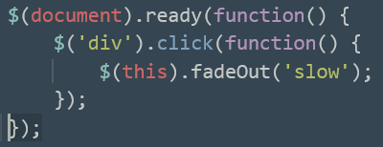
$(this)
With this, of course!
The this keyword refers to the jQuery object you're currently doing something with. If you use an event handler on an element—that's the fancy name for actions like .click() and .mouseenter(), since they handle jQuery events—you can call the actual event that occurs (such as fadeOut()) on $(this), and the event will only affect the element you're currently doing something with (for example, clicking on or mousing over).
Here’s the same code using ‘this’:

Slide 20
Creating HTML Elements
Dynamically adding elements to our HTML page is a powerful tool
—it lets us modify not only the formatting, but the actual
structure of our websites in response to a user's actions.
All we're doing is setting a variable equal to a jQuery object.
In this case, however, instead of just having something like:
$p = $('p');
We'll want to pass in an entire HTML element in quotes:
$p = $("<p>I'm a new paragraph!</p>");

Slide 21
Inserting Elements
jQuery allows us to insert our newly created elements into our
HTML document using a few jQuery actions.
.append() inserts the specified element as the last child of the target element.
.prepend() inserts the specified element as the first child of the target element.
For example:
$(".info").append("<p>Stuff!</p>");
$(".info").prepend("<p>Stuff!</p>");
If we have a div of class .info, the above code will add a
paragraph containing the text "Stuff!" inside all divs of class .info.

Slide 22
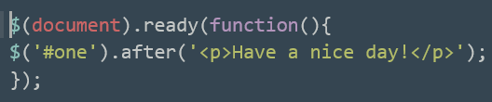
Before and After
We can specify where in the DOM we insert an element with the
.before() and .after() functions. The syntax looks like this:
$('target').after('<tag>To add</tag>');
Where 'target' is the element after which you want to add something
and the bit between <tag>s is the HTML element you want to add.
You can add <h1>s, <div>s, or any other valid HTML you like.
Example:

Slide 23
Removing Elements
Along with adding elements to our HTML documents, we also have the ability to remove
them. There are two jQuery functions available to help delete content from our pages.
.empty() - deletes an element's content and all its descendants
.remove() - not only deletes an element's content, but deletes the element itself
For instance, if you .empty() an 'ol', you'll also remove all its 'li's and their text.

Slide 24
Adding and Removing Classes
We don't have to limit ourselves to adding or removing entire elements, though
—we can fine-tune our jQuery superpowers to alter classes, CSS,
and even the contents of our HTML elements.
jQuery includes two functions, that can be used to add or remove a class from an element.
This is great if, for example, you have a highlighted class that you want to apply to an
element when clicked. The syntax looks like this:
$('selector').addClass('className');
$('selector').removeClass('className');
where 'selector' is the HTML element you want and 'className' is the class name
you want to add or remove.

Slide 25
Changing your Style
Because resizing elements is so common, jQuery has specific .height()
and .width() functions that can be used to change the heights and widths
of HTML elements.
For instance:
$("div").height("100px"); $("div").width("50px");
would give all <div>s on the page a height of 100 pixels and a width of 50 pixels.
jQuery also includes a general-purpose .css() function that takes two inputs:
the first is the CSS element to alter,
the second is the value to set it to.
For example:
$("div").css("background-color","#008800");
would give all <div>s on the page a green background color.

Slide 26
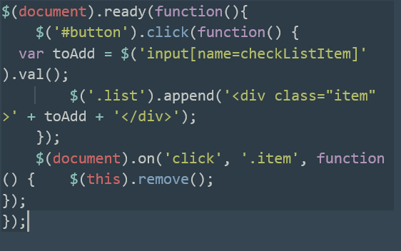
Interactive To Do List
This code combines a lot of the functions we’ve talked about:

Slide 27
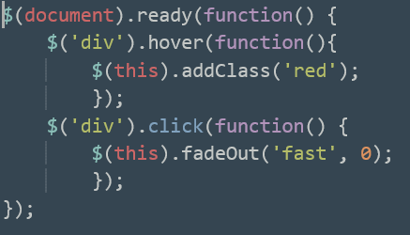
Combining .hover() and .click()
Let’s take a green planet, turn it red and make it disappear!
We can do this by combining the .hover() and .click() functions:

Slide 28
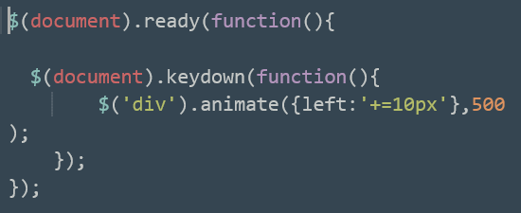
.keydown() and .animate()
We’re not limited to mouse events in jQuery
—we can trigger events using the keyboard, as well!
The .keydown() event is triggered whenever any key on the keyboard is pressed.
You can combine .keydown() with another effect: .animate() and use it to move
an object on the screen whenever we press a key.
The .animate() effect takes two inputs:
the animation to perform, and the time in which to perform the animation.
Here's an example that will take the first div it finds and move it ten pixels to the right:

Slide 29
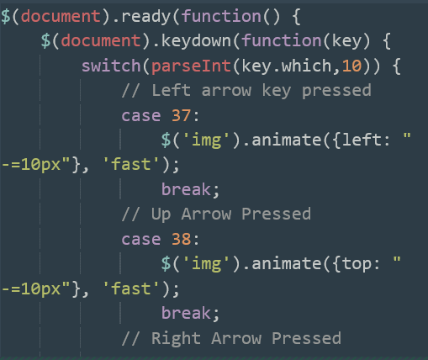
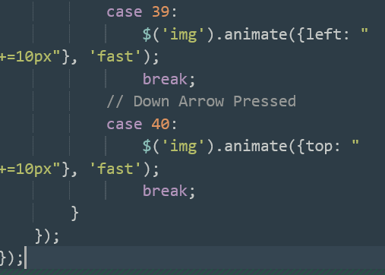
Let’s Move Mario

Slide 30
jQuery UI
jQuery UI - a new jQuery library that includes a number of ultra-fancy
animations you can use to make your websites do incredible things.
To use this library, you have to add an extra <script> tag in our HTML documents:
<script src="https://code.jquery.com/ui/1.12.1/jquery-ui.js"></script>
jQuery UI gives us the ability to perform some special effects.
.effect(), with input keywords to perform special effects
like 'explode‘ and ‘bounce’ and ‘slide’.
.draggable() function that can make any HTML element draggable
—you can click on it and move it anywhere on the page!

Slide 31
jQuery Mini-Course
You can find a good hands-on course on jQuery at:
https://www.codecademy.com/learn/jquery

Slide 32
Questions????

Slide 33
Thank you!!!

